Slide 1
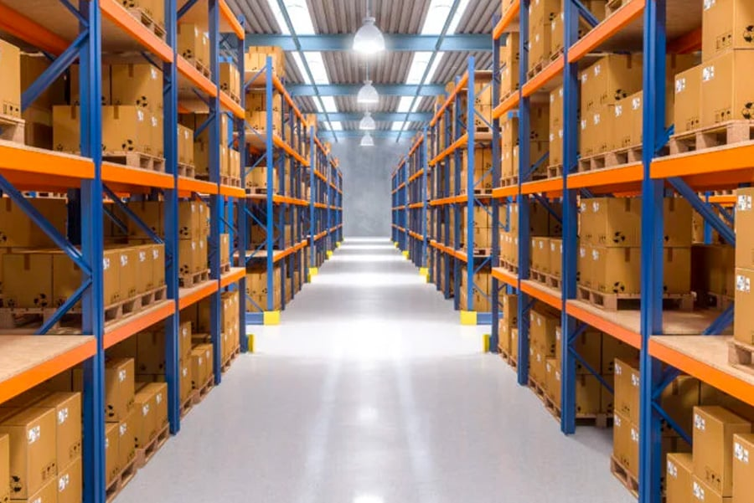


Warehouse Design — Milestone 1
A better layout for the Assa Abloy warehouse, run by DHL in Bemmel
Gleb · Rachel Selvarathnam · Arnau · Vidhi

Slide 2
What's in the Warehouse
ANALYSIS
The products stored and how much stock is on site (3 months of 2025 data)
5,291
~8,500
72.7%
21%
~3 days
Different products
Pallet spaces used (peak)
Products with 1 pallet
Stock over 1 year old
Order → shipped
The products
The stock
• 5,291 different products in 11 groups (locks, cylinders, fittings…)
• Most are small — a typical item is about the size of a coffee mug
• 2,176 (41%) are sold as single pieces, not full boxes
• A full pallet holds ~1,000 pieces and weighs ~431 kg on average
• 138 products are hazardous and must be kept apart
• At the busiest moment, ~8,500 pallet spaces were in use — this is our real storage need
• (~11,000 pallets fit in those spaces — some spaces hold two)
• Stock is growing: pallet spaces rose ~8% in 3 months — we must leave room to grow
• 73% of products need only one pallet — lots of slow sellers
• Same stock spread over more spaces → space is being wasted today
Project OTM — Assa Abloy @ DHL Bemmel · Deliverable 1 (Analysis)
2

Slide 3
What the Orders Look Like
ANALYSIS
How customers order tells us the best way to pick — not how DHL did it before
8,781
39,069
50.5%
5
Orders (3 months)
Order lines
Orders for 1 product
Pieces in a typical line
How customers order
So how should we pick?
• One "line" = one product on an order (39,069 lines in total)
• Half of all orders (50.5%) are for a single product
• Orders are small — a typical line is ~5 pieces, far below a full pallet (~1,000)
• Customers across NL, Belgium, Germany, France — an NL hub for Western Europe
• Lots of small orders → let pickers collect several orders in one trip
• Many single pieces → keep best-sellers in a small, easy-to-reach picking area
• Full-pallet picking is rarely needed
• We base this on the orders themselves, not on how DHL happened to do it before — so the 20% of unlabelled picks don't affect our design
Project OTM — Assa Abloy @ DHL Bemmel · Deliverable 1 (Analysis)
3

Slide 4
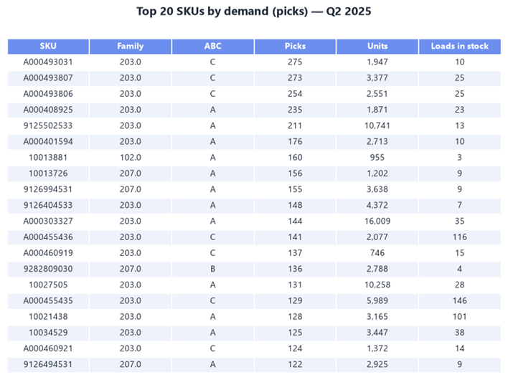
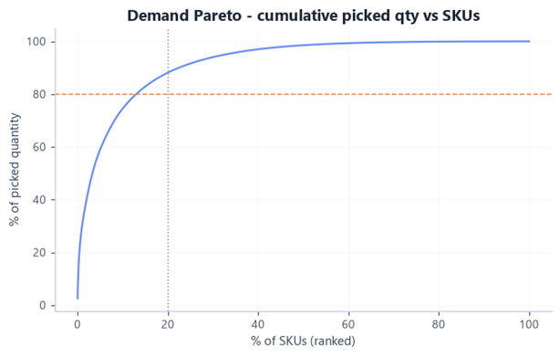
Which Products Sell the Most
ANALYSIS
We ranked every product by how often it's actually ordered
The 80/20 rule — even stronger
• A — the stars: 13% of products = 80% of what ships
• B — steady: 20% of products = 15%
• C — slow: 67% of products = only 5%
Today only about half the products are stored by how often they sell — so many best-sellers sit far from the door. They should move closer.
Project OTM — Assa Abloy @ DHL Bemmel · Deliverable 1 (Analysis)
4

Slide 5
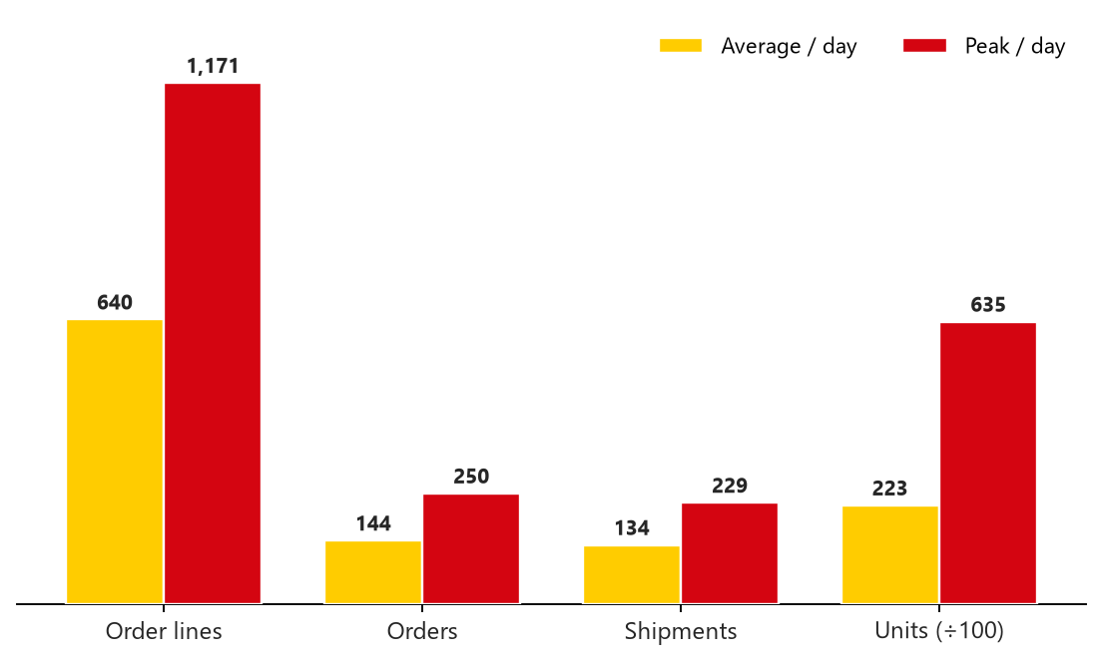
Busy Days vs Normal Days
ANALYSIS
The warehouse must cope with the busiest days, not just the average
A NORMAL DAY VS THE BUSIEST DAY
THE NUMBERS
 | Normal day | Busiest day | How much more | When
Order lines | 640 | 1,171 | 1.8× | 27-May-25
Pieces | 22,269 | 63,469 | 2.9× | 27-May-25
Orders | 144 | 250 | 1.7× | 29-Apr-25
Shipments | 134 | 229 | 1.7× | 29-Apr-25
Plan for the busy days. On the busiest day the warehouse shipped nearly 3× the usual pieces, so it needs spare capacity.
Pieces are shown ÷100 so all four bars fit on one scale.
Busy weeks too
Why 08:00 is the busiest hour
The busiest week handled 3,563 lines vs ~2,791 normally — a busy spell, not just one day.
It's the order release, not demand. Afternoon orders are released at 16:00–17:00 and picked next morning. Mon–Fri only.
Project OTM — Assa Abloy @ DHL Bemmel · Deliverable 1 (Analysis)
5

Slide 6
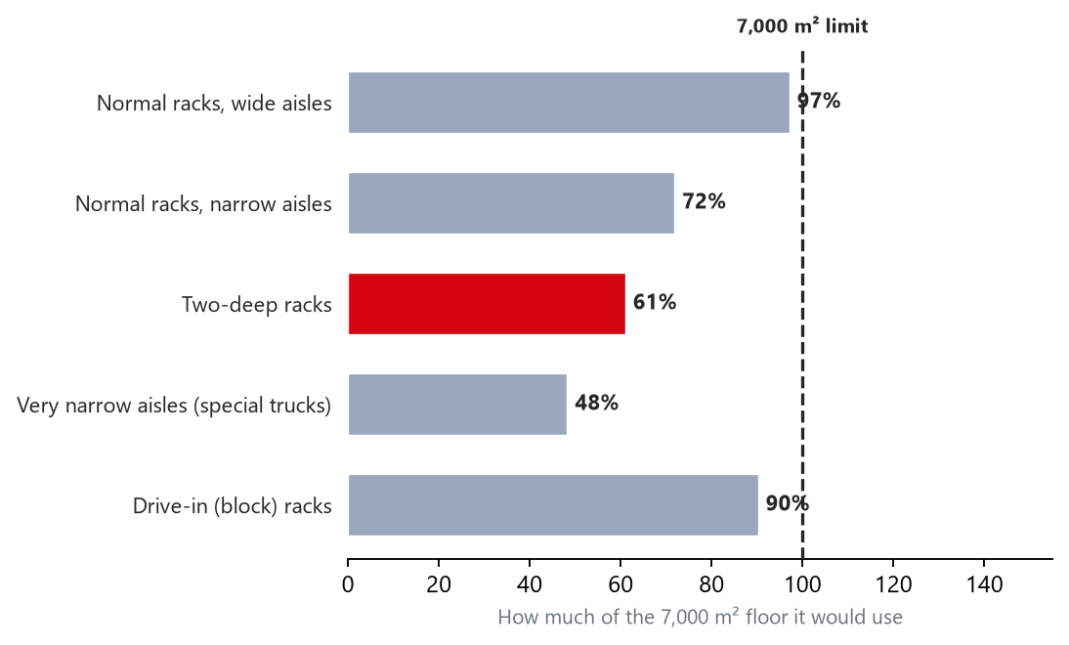
How Much Storage We Need
RECOMMENDATION
Sizing the warehouse on solid numbers
~8,500
~9,500
8
Pallet spaces at peak
Spaces we'll build for
Levels high (up to 12.2 m)
How we sized it
• The busiest day used ~8,500 pallet spaces — that's the real need
• We plan for ~9,500 so racks are never 100% full (easier to work)
• Growth is handled by tall racks, not by adding a big safety number
• This replaces our earlier 14,074 — too high, per the feedback
Floor space each storage style needs vs the 7,000 m² limit.
Two-deep racking fills only ~61% of the space — plenty of room. So we choose on efficiency, not just fitting in.
6

Slide 7
Three Options — and Why We Pick B
RECOMMENDATION
Every choice works together across the whole warehouse
WHY OPTION B — WHAT WE FOUND → WHAT WE DECIDED
Option A — Keep it simple
· Normal racks, narrow aisles
· Pick orders one by one
· Uses ~72% of the space
· Cheapest, but most walking
Many slow sellers + need room to grow
→
Store pallets two-deep — saves space, less walking
Lots of single pieces and small orders
→
A small fast-pick area near the door
Option B — Best balance ✓
Best-sellers stored in the wrong places
→
Put the most-ordered items closest
· Two-deep racks + fast-pick area
· Pickers work zones, many orders/trip
· Uses ~61%, room to grow
· Best mix of space & effort
Half of orders are for one product
→
Pickers collect several orders per trip
Option C — Automated
Some hazardous and some very long items
→
Separate area + special long-item racks
· Very narrow aisles + machines
· Machines bring items to pickers
· Uses ~48% (tightest)
· Most expensive & complex
Busiest day ~3× the average
→
Size the pack & ship area for busy days
Project OTM — Assa Abloy @ DHL Bemmel · Deliverable 1 (Analysis)
7

Slide 8
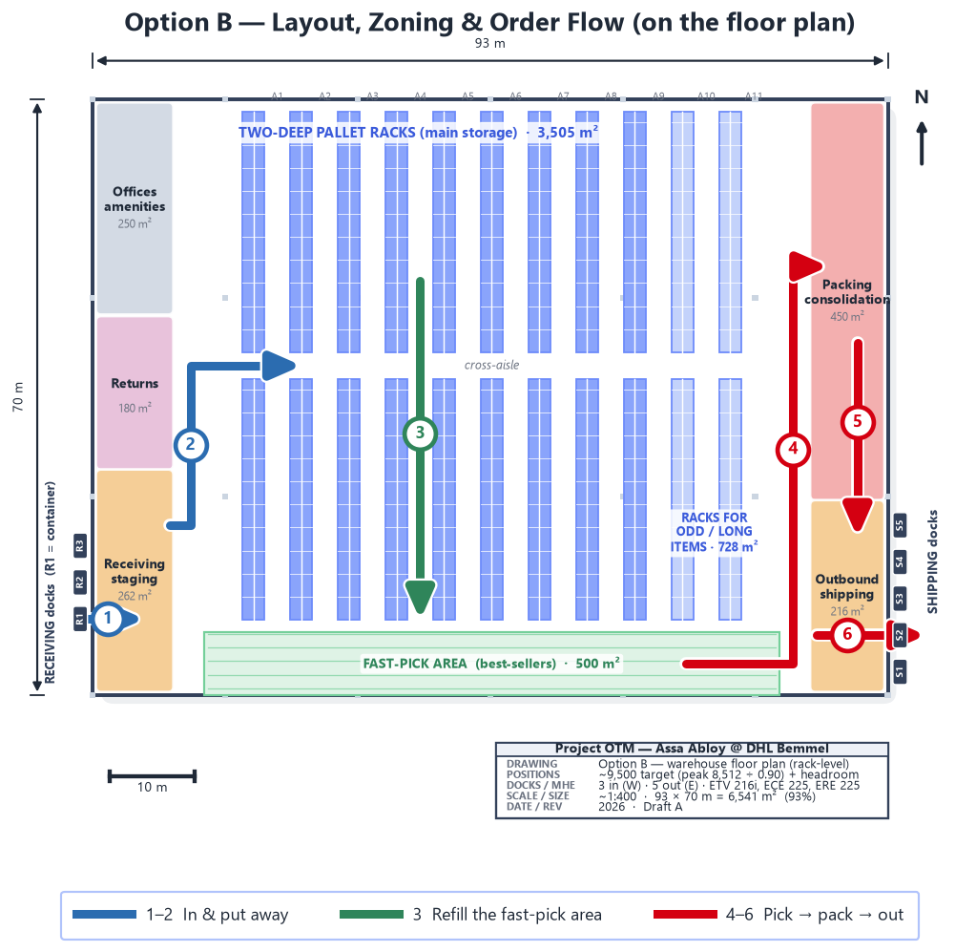
Our Recommended Layout
RECOMMENDATION
The full floor plan, drawn to scale, showing how goods move
The areas
• Two-deep racks for the many slow sellers
• Special racks for odd or long items
• A fast-pick area for the best-sellers
• Goods-in, returns, packing, shipping, offices
How goods move
• In → put away → refill → pick → pack → out
• Best-sellers picked from the fast-pick area up front
• 3 receiving doors (west) + 5 shipping (east) → straight-through flow
• Uses 6,541 m² (93% of the limit), with room to grow
Project OTM — Assa Abloy @ DHL Bemmel · Deliverable 1 (Analysis)
8

